Slide 1
IntRoduction to Kubernetes with AKS
South Florida Software Developers Conference – Feb 2020
JvB, Consulting Architect, Rancher Labs

Slide 2


Howdy, I’m JvB
Jason van Brackel
Consulting Architect
@jasonvanbrackel
Github: jasonvanbrackel
jvb on rancher-users

Slide 3
Objectives
An Introduction to Kubernetes with AKS
Ask Questions

Slide 4
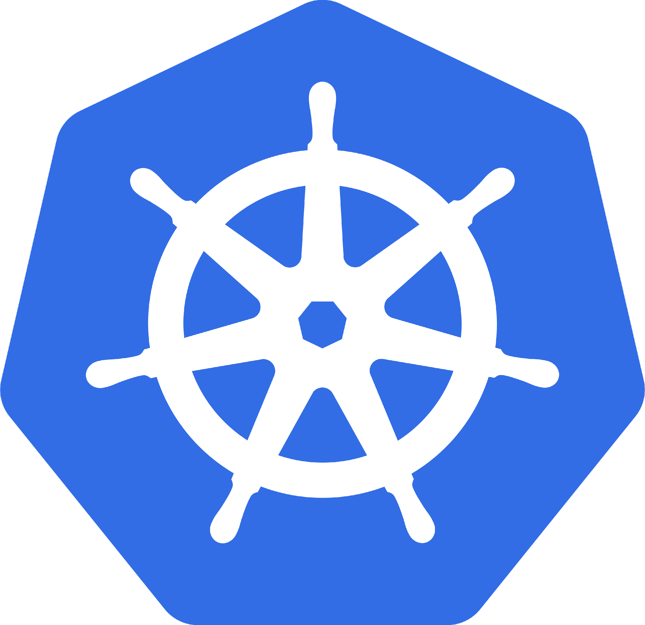
What is Kubernetes
Orchestrates Containers
That’s it? That’s all it does!

Slide 5
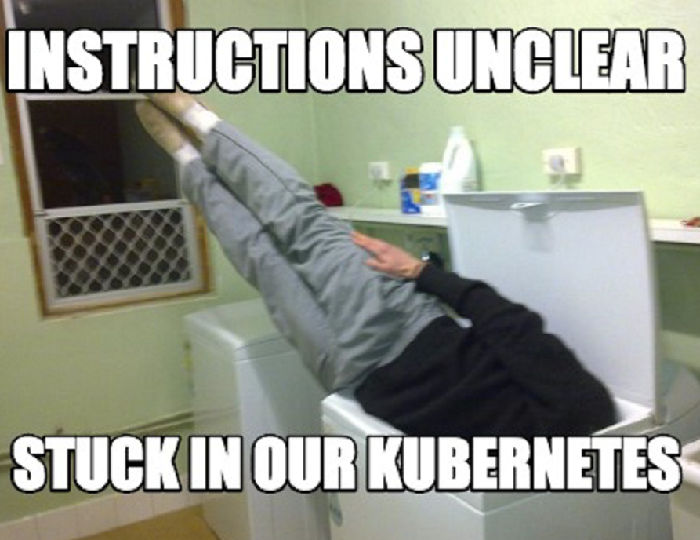
Then Why is it some Complex?
Scale
Kubernetes Reference API
What is Kubernetes Physically Speaking?

Slide 6
Why Should I care?
Developers
Operators
It Won !?!?

Slide 7

Why Should Developers care?
Containerized Applications
Breaking the Monolith
It’s the Substrate

Slide 8
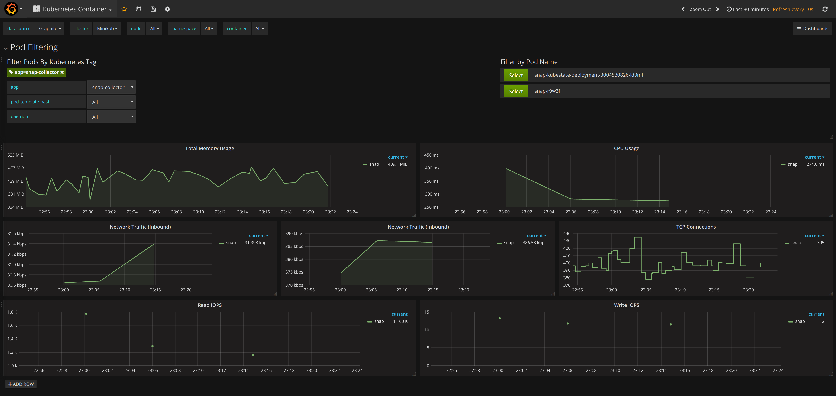
Why Should Operators care?
They’re running it.
Scale
It’s here and you can’t stop it.
https://grafana.com/grafana/plugins/grafana-kubernetes-app

Slide 9
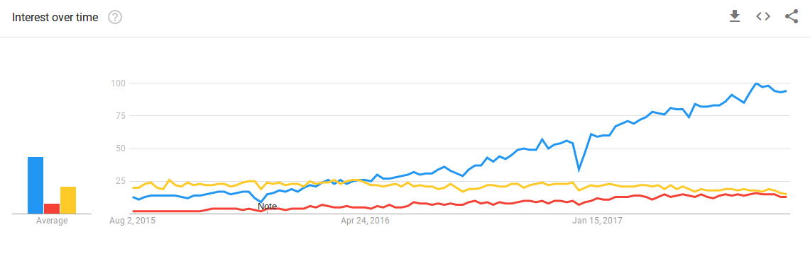
It Won!?!
https://containerjournal.com/features/measuring-kubernetess-market-share-mind-share/

Slide 10
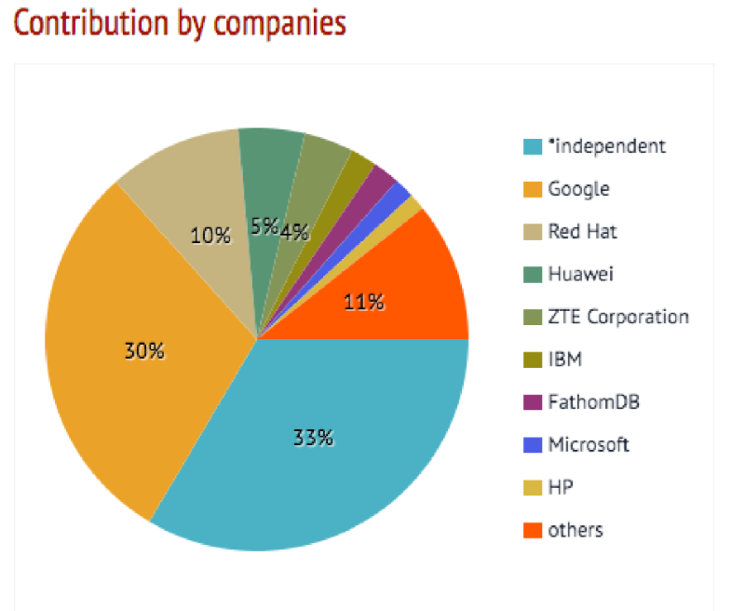
It WoN!?!

Slide 11

AKS – Azure Kubernetes Service
Highly Available
Managed Control Plane
Backed By AKS Engine

Slide 12
Why AKS?

Slide 13

Or Maybe Not?
Multi-Cluster
Hybrid Cloud
More Control
Windows Features
SLA

Slide 14
Let’s Create an AKS Cluster
Azure Portal
Azure CLI
ARM Templates
Terraform
Pulumi
Rancher

Slide 15
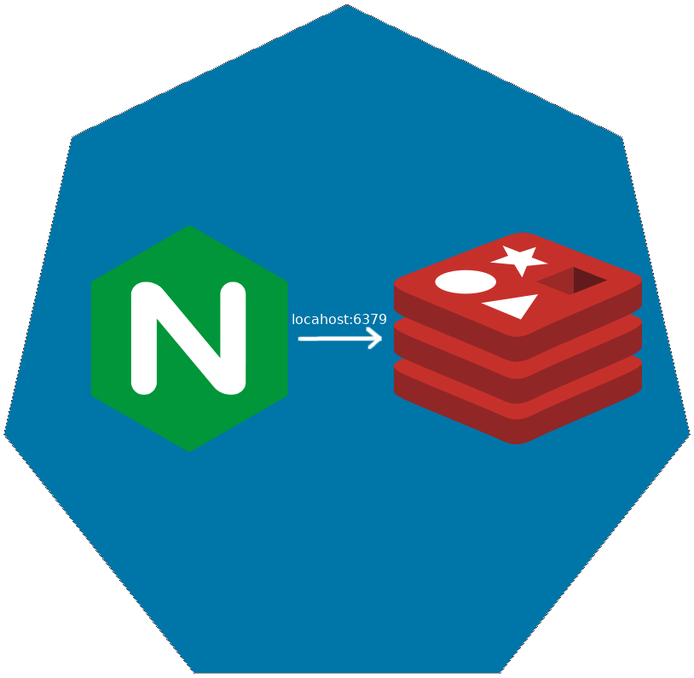
Pod
Co-scheduled
Shared Network Namespace
Shared Files System

Slide 16

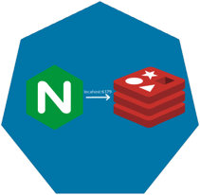
Replica SET

Slide 17

Replica SET

Slide 18
Replica SET

Slide 19
Deployments

Slide 20
Deployments

Slide 21
Deployments

Slide 22
Deployments

Slide 23
Deployments

Slide 24
Services
Define a DNS entry that can be used to refer to a group of pods
Provide a consistent endpoint for the group of pods
Different types: nodePort, clusterIP, loadbalancer
#rancherk8s

Slide 25


Services (Node Port)
192.168.0.[1-3]:32000

Slide 26
Services (Load Balancer)
Public IP:80

Slide 27
Config Maps & Secrets
Allow storing of arbitrary configuration values and files
Exposed in pods as either environment variables or as local storage
Decoupled storage of configuration from pod spec
#rancherk8s

Slide 28
Config Maps & Secrets
apiVersion: v1
kind: ConfigMap
metadata:
name: dev-config
namespace: default
data:
Item1: dev-stuff
Item2: more dev stuff
apiVersion: v1
kind: ConfigMap
metadata:
name: qa-config
namespace: default
data:
Item1: qa-stuff
Item2: more qa stuff
apiVersion: v1
kind: ConfigMap
metadata:
name: prod-config
namespace: default
data:
Item1: prod-stuff
Item2: more prod stuff

Slide 29
Ingresses
Define how traffic outside the cluster is routed to inside the cluster
Used to expose Kubernetes services to the world
Route traffic to internal services based on factors such as host and path
Ingress is usually implemented by a load balancer (Nginx, HAProxy, AWS ELB, etc…)
#rancherk8s

Slide 30

Ingresses
Ingress Controller
https://my-nginx-app.cluster.com https://cluster.com/my-nginx-app

Slide 31
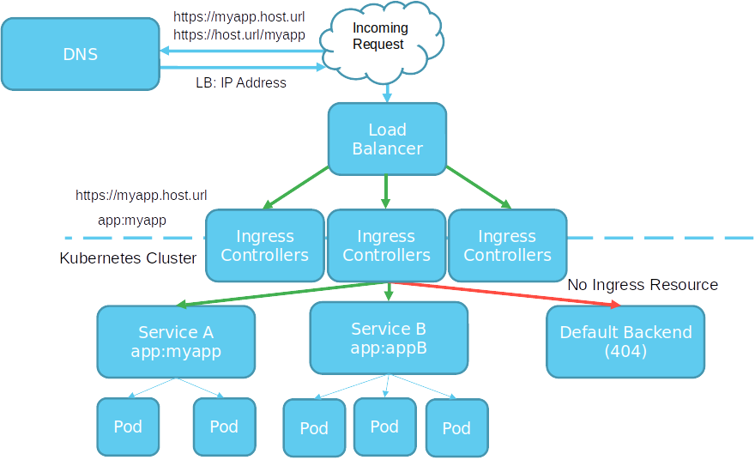

Slide 32
More Resources
Kubernetes Docs
Kubernetes Slack
Rancher Slack
Lean Kubernetes Basics
The RanchCast On Twitch
The RanchCast On YouTube
Rancher On YouTube
Lots of Free Training

